Slide 1
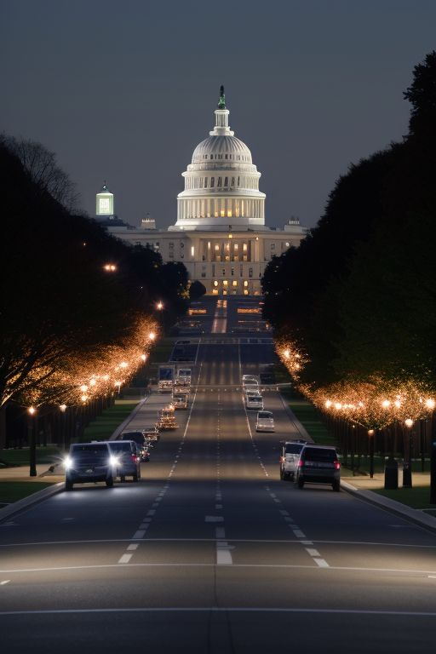
Washington DC Street Light Visualisation and Analysis
Data Visualisation Track
Group 2
Fabiano Santos
Laura Rui Liu
Lewis Trenerry
Madeleine Chapman
Oliver Uy

Slide 2









Pathway to Success
Brainstorming
Extract
Export
Data Manipulation
Track
Transform
Load
Visualisations
Discussed options
Identified sources
Split work
Web Scraping
US Navy
Download files
Open data DC
72k rows
Cleansing
Structuring
CSV files ready
Created DB
Prepared view
Read from DB
Charts
Maps

Slide 3
Before we go…
Ethics Considerations
Open Data and Data integrity
Utilizing multiple data sources to ensure unbiased conclusions
Reference to several US Government websites for credible data
Insights
Seasonality of utility consumption in Washington D.C. area
Different types of lightening
Potential Targets
Power industries
Public maintenance services;
Lighting manufacturing for strategic planning and operational efficiency.

Slide 4
hank you!

